Slide 1
Audio Sentiment Analysis
Term Project
Alexander Wang
Notes:
YouTube Demo of Application
https://youtu.be/Nj25epGkF54
Application Link
https://call-text-analysis.uc.r.appspot.com
GitHub
https://github.com/wangalexandersk/call_text_project

Slide 2
Business Case
1

Slide 3
Scenario
Company: Golden Lion Bank - Over 1000+ Investment Advisors
Sponsors: Personal & Commercial Banking
Stakeholders: Investment Advisors have to spent a lot of time doing research on companies to determine companies to invest in for their clients
Including listening to earnings calls which can last up to 2 hours (for one company) - Market Sentiment
How can we help IAs save time by using NLP?

Slide 4
Market sentiment refers to the overall attitude of investors toward a particular security or financial market. It is the feeling or tone of a market, or its crowd psychology, as revealed through the activity and price movement of the securities traded in that market. In broad terms, rising prices indicate bullish market sentiment, while falling prices indicate bearish market sentiment.

Slide 5
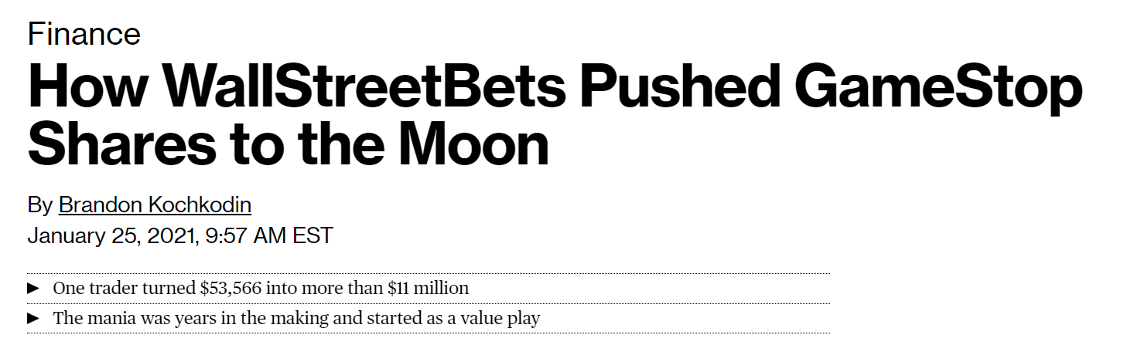
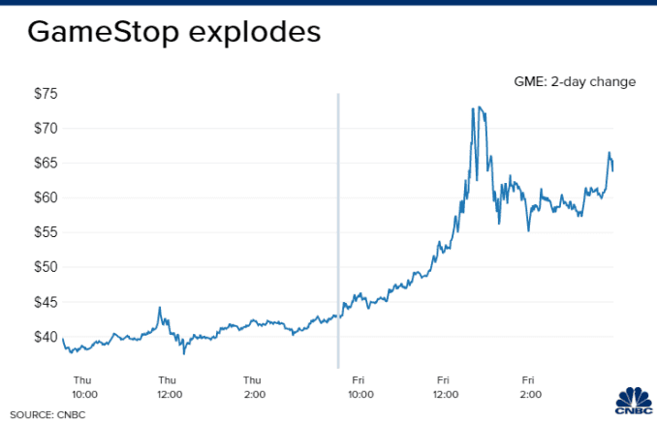



Slide 6
Requirements
Scalable - Support for increased transaction volume, or increased compute power on demand
Cost effective - Less upfront cost (Low CAPEX)
Secure - Can set access permissions and support encryption
Low Maintenance - Reliable - Have failover and additional servers
Setup quickly (initial POC) - Without requiring too much time to configure and acquire equipment

Slide 7
Cloud vs On-Prem Matrix (Effort Required)
Low to High Effort Required | Cloud | On-Prem | Recommendation
Scalability | Low | High | Cloud
CAPEX | None | High | Cloud
OPEX | Medium | Medium | Tie
Security | Medium | High | Cloud
Maintenance | Low | High | Cloud
Setup | Low | High | Cloud
Notes:
Uptime is best for Cloud

Slide 8
GCP vs AWS
Google Natural Language API (Sentiment)
$0.0001 up to 1M units (Monthly)
1 unit = 1000 characters
No minimum (Free) with 0-5K units
$0.0010 per character
Google Speech to Text API (Standard)
$0.00040 ($/second)
Free within 0-60 minutes
AWS Comprehend (Sentiment)
$0.0001 up to 10M units (Monthly)
1 unit = 100 characters
3 unit = 300 characters min per request
Free up to 50K units of text
$0.01 per character
AWS Transcribe
$0.00040 ($/second)
Free 60 minutes per month
Assumptions:
10,000 requests a month
Average recording length 60 minutes

Slide 9
GCP vs AWS
GCS Bucket
20.48 USD per Month (Standard) - Iowa US Central-1
Google App Engine
F1 (1GB Memory)
0 USD (Includes Free)
AWS S3 Bucket
26.37 USD per Month (US East Ohio)
AWS Lambda
1GB Memory
0 USD (Includes Free)
Assumptions:
10,000 requests a month
Average recording length 60 minutes (100MB) - 1TB Total
Notes:
GCP is cheaper in regards to storage and using each API per unit/character

Slide 10
Solution Architecture
2
Notes:
https://github.com/wangalexandersk/call_text_project

Slide 11
Functionality
Need to transcribe audio recording
Need to process the text and analyze the sentiment
Web facing application which the user will upload an audio recording
Hosting the web application
Storing the raw text and store the audio files

Slide 12

Technology
Speech to Text API - Audio Transcribe
Natural Language API - Analyze Sentiment
Flask/Python to serve the application to the user
App Engine to host the application
GCS Bucket (Standard) to store the text and audio files

Slide 13
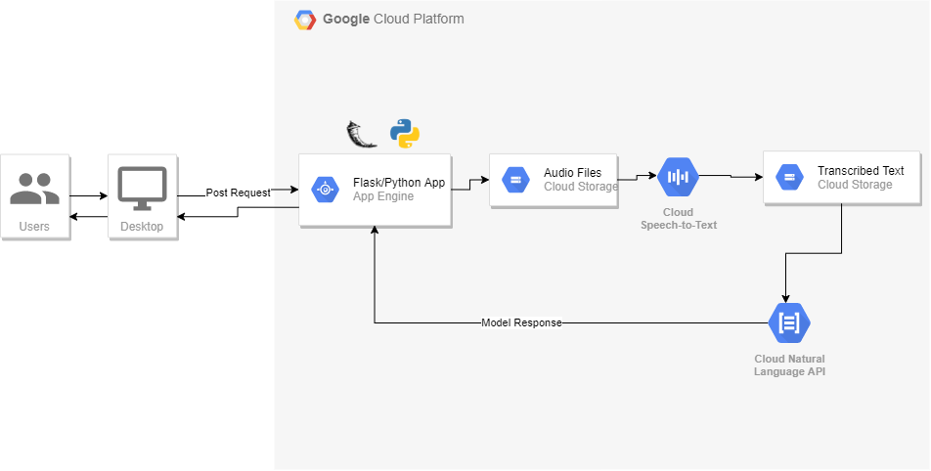
Notes:
Draw IO diagram

Slide 14
Demo - Solution
3

Slide 15
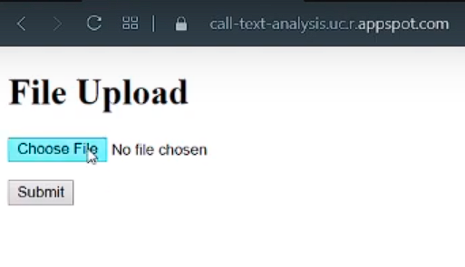
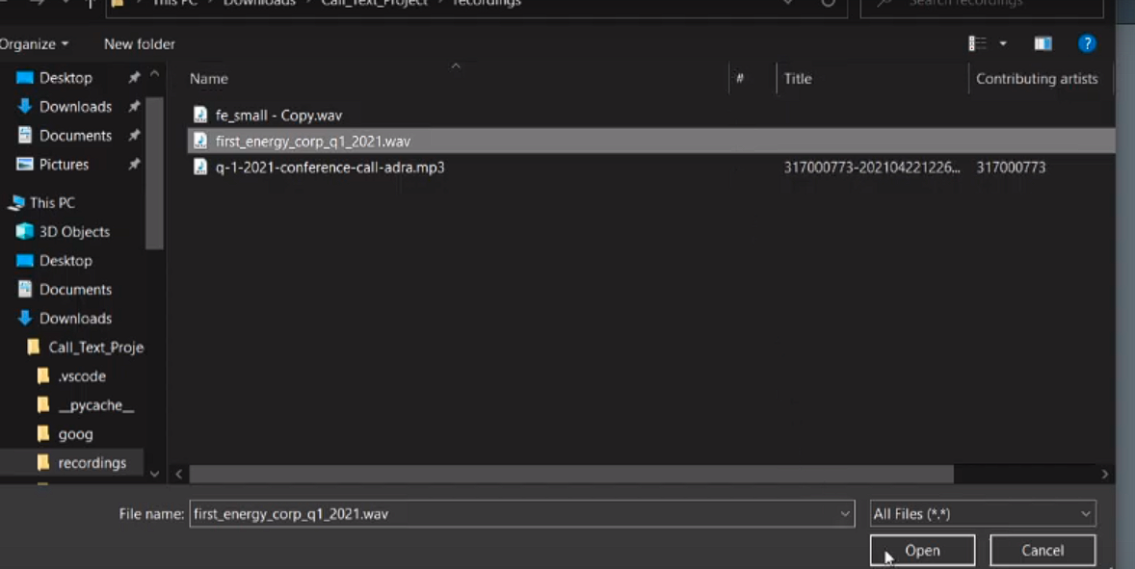
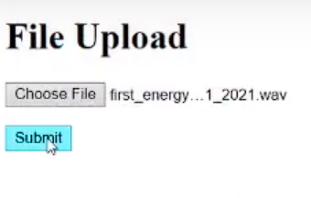
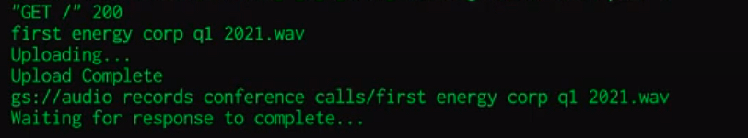

Slide 16
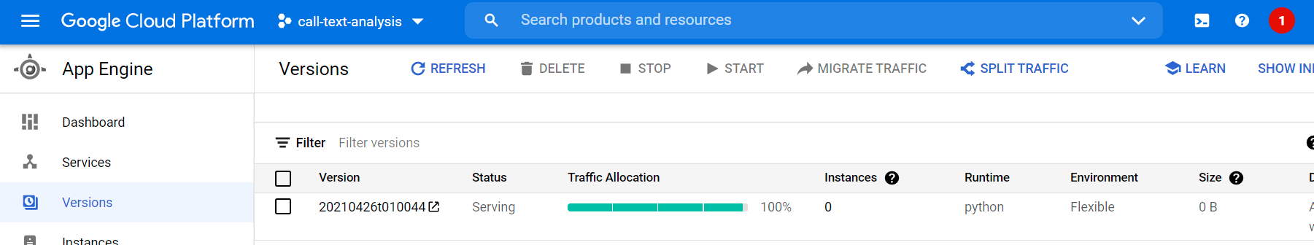
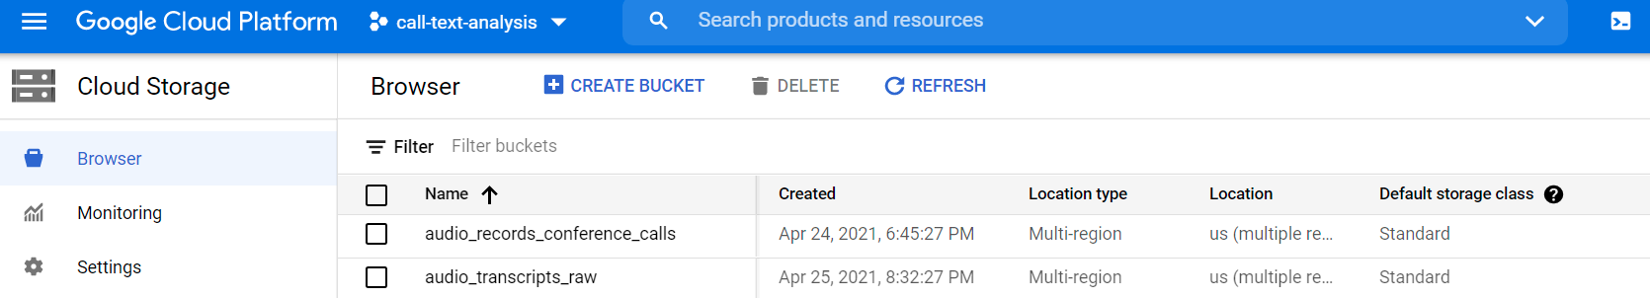

Slide 17
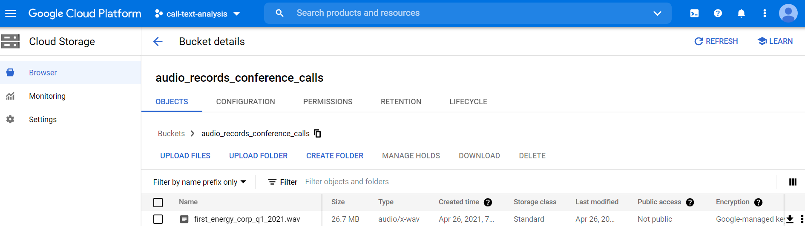
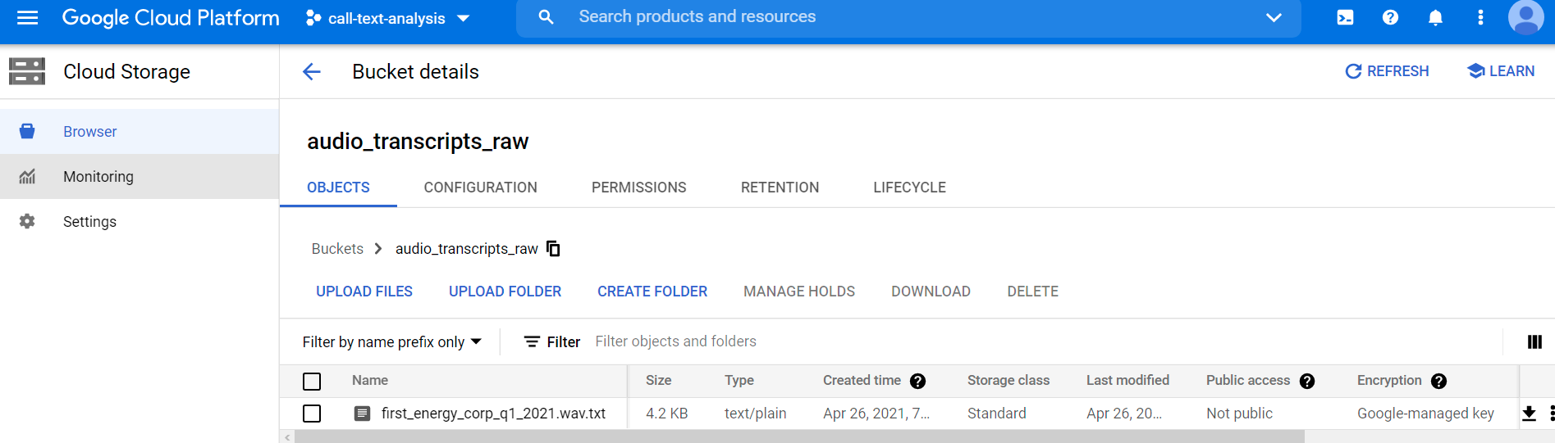

Slide 18
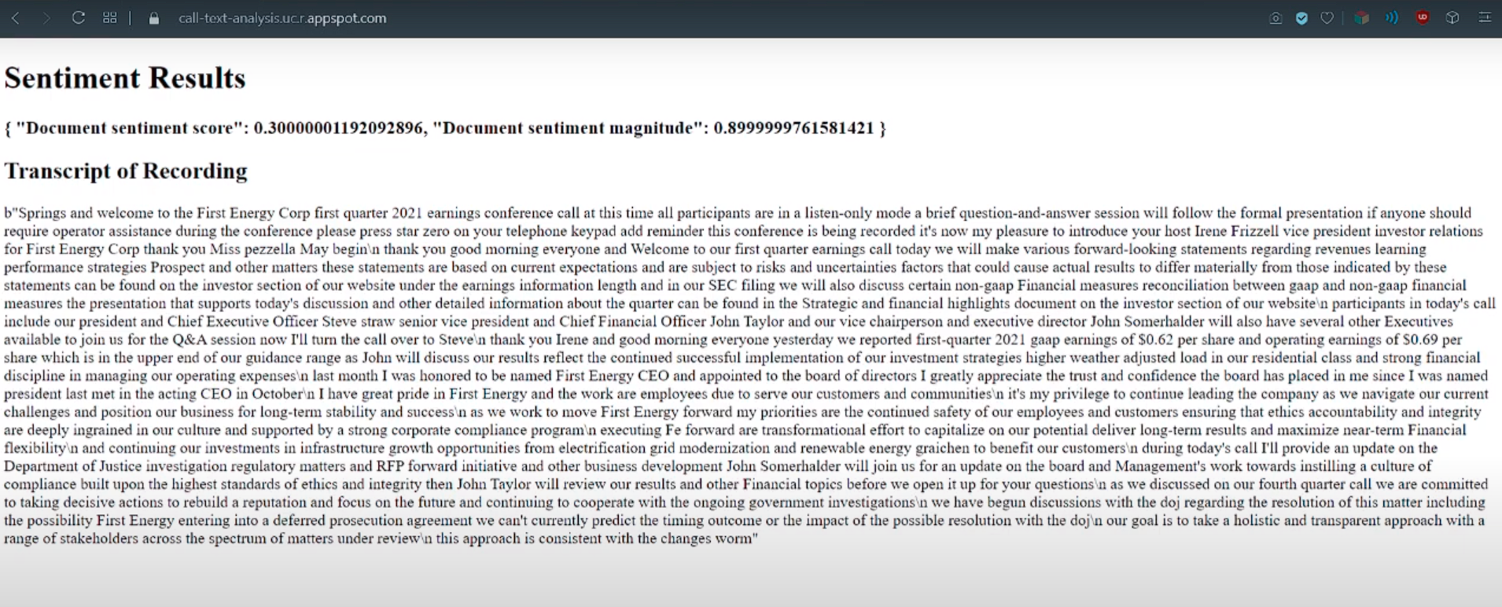

Slide 19
Final Thoughts
4
Notes:
Link to demo
https://youtu.be/Nj25epGkF54
https://call-text-analysis.uc.r.appspot.com

Slide 20
Challenges & Lessons Learned
Have to compromise between each providers - Look at from holistic perspective
Overall solution rather than individual pieces
Cost is not super intuitive to calculate (need to estimate demand)
Local development != Cloud environment
Many many different ways and tools to solve a problem

Slide 21
Thanks
Any questions?

Slide 22
Appendices
YouTube (Demo)
https://youtu.be/Nj25epGkF54
Application Link
https://call-text-analysis.uc.r.appspot.com
GitHub
https://github.com/wangalexandersk/call_text_project
Notes:
Link to demo
https://youtu.be/Nj25epGkF54
https://call-text-analysis.uc.r.appspot.com

